Slide 1
Closing Session

Slide 2
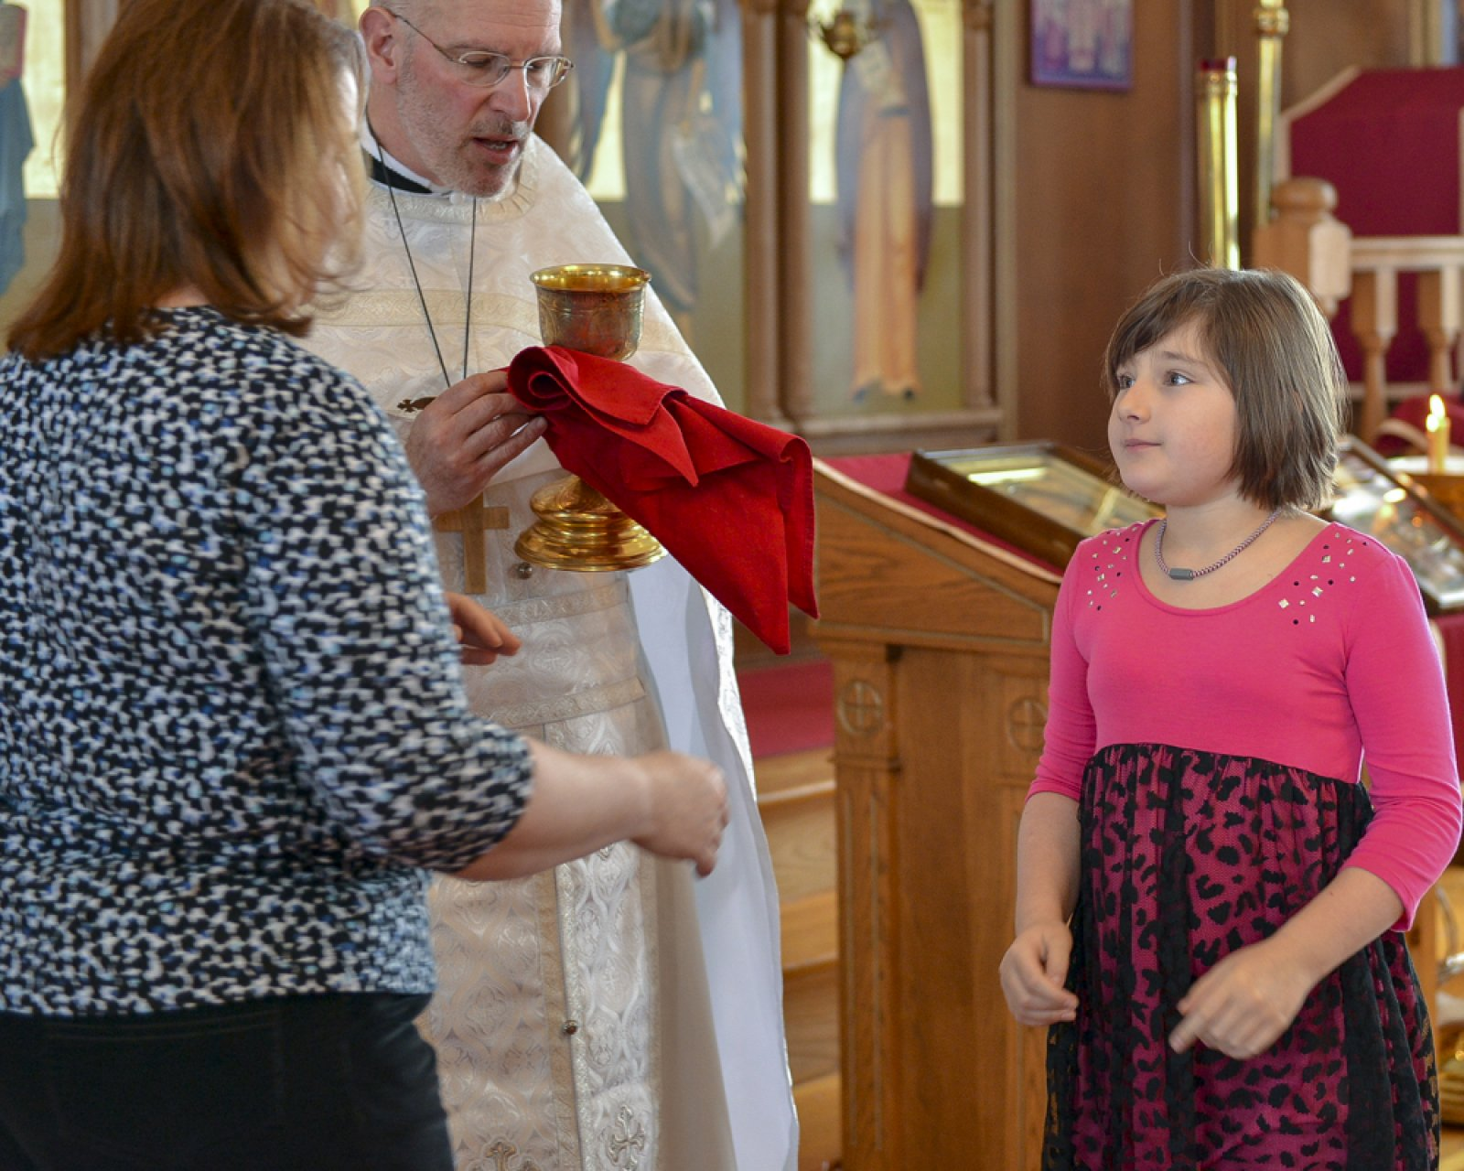
“Any Parish Can Become Vibrant…
“All that is required is that its members, beginning with its leaders, be firmly resolved to have it so.”
Fr. Thomas Hopko

Slide 3
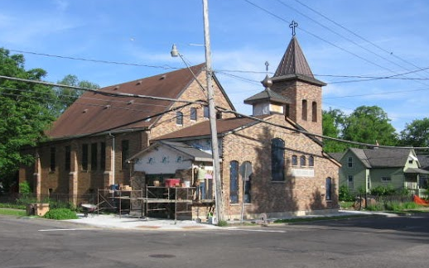
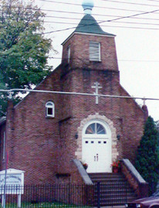
Little Parishes (Engines) that Could …Conferences Help
“… we have a new-born ministry to the depressed neighborhood around our church, that is just taking its first steps. …the confidence to embark on that whole vision has its roots directly in the urban parish conference in Cleveland. …a difference was made, in very concrete terms, to the day-to-day life of our own local church, in ways small and very large.”
Holy Trinity Church
16 >> 84

Slide 4
Adopting a New “Paradigm”
A different model of Orthodox parish
Holiness …Sacraments… Service… Apostolic zeal
²² put away your former way of life….
²⁴ …clothe yourselves with the new self, created according to the likeness of God in true righteousness and holiness.
Ephesians 4:22,24

Slide 5
Parishes Can Become More Vibrant Excerpt from Parish Warden Report
“Today we think and act differently as a parish community.
No longer are we focusing on our existence as a parish, but instead on what kind of a parish we should be.
Father ____ made the observation that we no longer spend a day selling cookies to help our finances but now spend two days to provide a weeks worth of groceries and gifts to over 200 families.
We now think less in terms of what we have accomplished but instead are thinking of how much more we can do. Can we support food efforts for 300 families, 400 families or more?”
The parish grew by 22 persons between 2007 and 2011.

Slide 6
Broccoli Effect
“Because its good for them…
… does not mean they will eat it.”

Slide 7
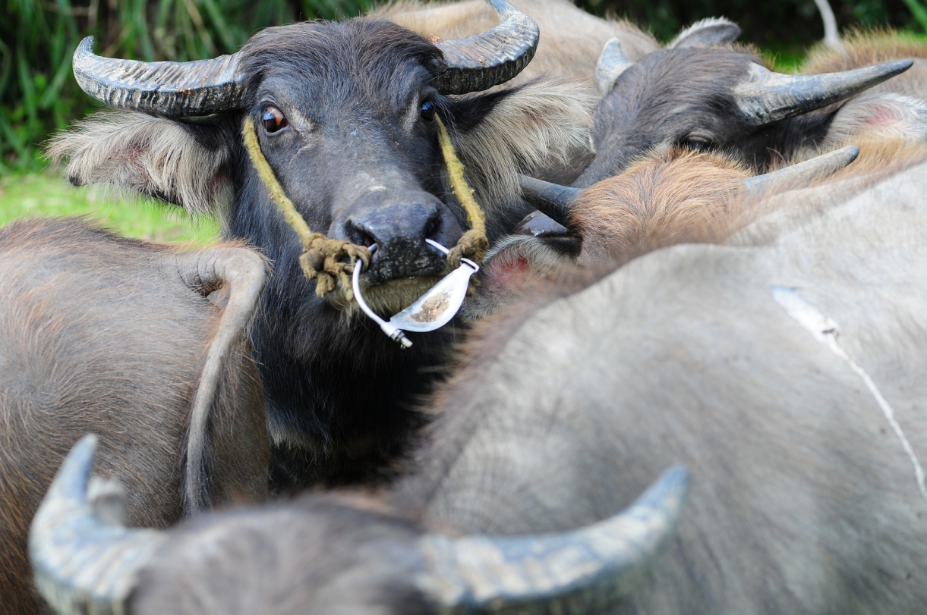
“The Law of the Buffalo Bridle”
“You can make a buffalo go anywhere you want him to go… as long as he already wants to go there.”

Slide 8
Prerequisites for Change
People must believe
that the parish has (an important) problem/ opportunity
Want to solve it (desire benefits of solution) ;
No big negatives will result
The problem can be solved/ addressed (others have done it)
We have the resources/capability to address it
The world (context) is not against us
We have a clear agreed upon vision of what we’re trying to do.

Slide 9
Motivation

Slide 10
Motivation is Critical
“There are only two motivators: Crisis and Vision”
Push | Pull
Prevention | Promotion,,;,
fear of failure/loss | excitement of something better
Concerns, crisis | desire, anticipation; hope vision
unpreferred present | preferred future

Slide 11
Faced with the prospect of changing one’s mind and proving there is no need to do so almost everyone gets busy on the proof.
John Kenneth Galbreath

Slide 12
A Five Stage Model of Change
Pre-contemplation Stage | Contemplation Stage | Preparation Stage | Action Stage | Maintenance Stage
Unfreezing
Changing
Re-freez-ing

Slide 13
Pre-contemplation Stage | Contemplation Stage | Preparation Stage | Action Stage | Maintenance Stage
State of benign ignorance Proposals at this stage are met with disbelief, disagreement, apathy, defensiveness resistance For people to consider a change it needs to be presented in a way that people understand from their current frame of reference. | Have become aware Learning phase marked by struggle to understand real nature of the issue Called to develop new sense of reality – can lead to procrastination as away to deal with insecurity Movement happens only when pros outweigh cons. | Strategies for change are chosen When they believe this will work they conclude “we can do this”. | When individuals try new behavior Need greatest motivation: takes most energy Often revert to past behaviors Frustrating and demoralizing since often interpreted as change not possible – but may be learning experiences providing clues for improving action. | New practices are habit of the people Active work ends when new habits are sufficiently in place so that threat of relapse is gone.
Unfreezing
Changing
Re-freez-ing

Slide 14
Unfreezing Mechanisms
Forces for Remaining Frozen
Thawing Mechanisms
Naturally tend toward equilibrium
Fear uncertainty/ timidity
Orthodoxy ≠ new ideas
Intentionality not our strength
Insularity
Aging parish/ Stuck in past/ Nostalgia
‘Just Hang on ‘til I die’
Occupied elsewhere
Gatekeepers; power; control
Sympathy – prefer ‘struggling parish’
DKWYDK: lack “models”
Love of Christ – sense of mission
Smell coffee – ‘view of gallows’
“Not gonna take it”
Love of parish/inheritance
Realize past is gone
Glimpse of something better
Language of excellence
New arrivals/ new ideas/ new priest
An external change
Catastrophe
New Questions/conversation

Slide 15
Change Mechanisms/Catalysts
Someone raises a key topic of discussion …Vision/Mission discussion; Budget conversation
Somebody quits/leaves
New people bringing new ideas
‘Retirement’ of the guy who does everything here
Exposure to something better -- Leaders get a glimpse of new results –that fit inward sense of mission so powerfully as to disturb old comforts & make status quo untenable.
Worship change >> seen by all something feels different then linked to another change
Attendance at Conference; webinar; speech – create learning/trying environment.
Grants – external stimulus designed to remove obstacles to achieving a modest internal forward moving action.

Slide 16
Tactics to Help with Change, Denial & Resistance
Clarify alternative - downside of not changing.
Get specific – what really changes?
Focus on benefits
Direct personal visits -- 1:1 or small groups.
Small steps >> focus
Grants
Communicate; communicate; communicate some more
Tough skin. (Occasionally) … Revitalization is not for sissies

Slide 17
Anchoring Mechanisms
Things that can help embed the change into the culture of the parish:
Earmarked $ for ministry
Core group formation (organic or explicit action)
Leadership covenant
Slaying the dragon (gatekeeper)
Training
A trip

Slide 18
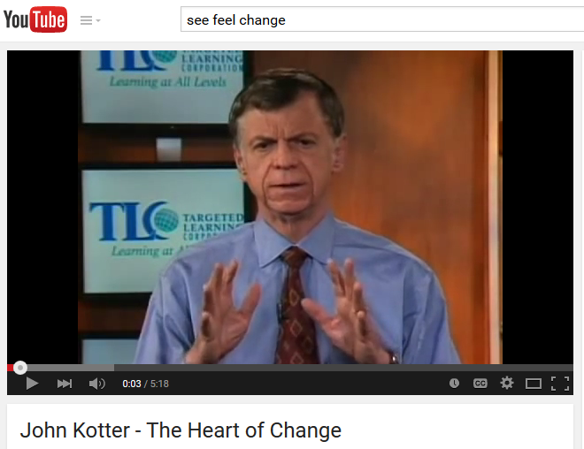
See - Feel - Change
Not…
Analyze –think –change
List ways to make people feel… your change
https://www.youtube.com/watch?v=1NKti9MyAAw

Slide 19
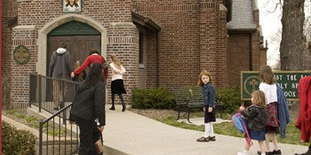
Drivers of Growth are Under Your Control
1. Come to church
2. Do something for others
3. Make people aware of your parish.
4. Engage newcomers/ visitors with care & warmth.
5. Give them a reason to return – expressed and experienced.

