Slide 1
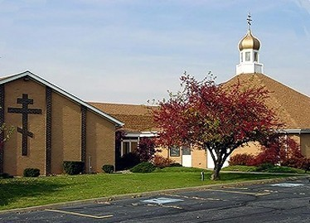
Becoming Stewards of Our Parish Future

Slide 2
Faculty & Staff
Clergy
Laypersons
Fr. Daniel Rentel
Fr. Marc Vranes
Fr. Tom Soroka
Fr. Stephen Frase
Fr. Jonathan Bannon
David Drillock
AnnMarie Mecera
Joseph Kormos
John Fedorko
Cathy Vrugitz

Slide 3
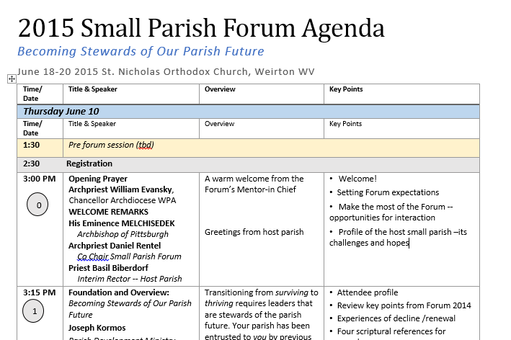
Agenda
Presentations
Discussions
Workshops

Slide 4
Thank You!
Your time this week
Your past labors
Your willingness to consider new approaches
Notes:
Principles and applications that follow may come as a change in focus and direction for many of you dedicated people.

Slide 5
Thank You!
Your time this week
Your past labors
Your willingness to consider new approaches
Also to our Supporting OCA Dioceses
Archdiocese of Pittsburgh
and Western Pennsylvania
Diocese of Chicago and the Midwest
Notes:
Principles and applications that follow may come as a change in focus and direction for many of you dedicated people.

Slide 6
Thank You!
Your time this week
Your past labors
Your willingness to consider new approaches
And too Our Hosts!
Notes:
Principles and applications that follow may come as a change in focus and direction for many of you dedicated people.

Slide 7
Future
Becoming Stewards of Your Parish Future
Thriving
Current Reality
Vibrant 21st Century North American Orthodox Parish
?
or
Opportunity Gap
Your Parish Today
The good & less good
Surviving
A shadow of what you could have become – and what you are in 2015?

Slide 8
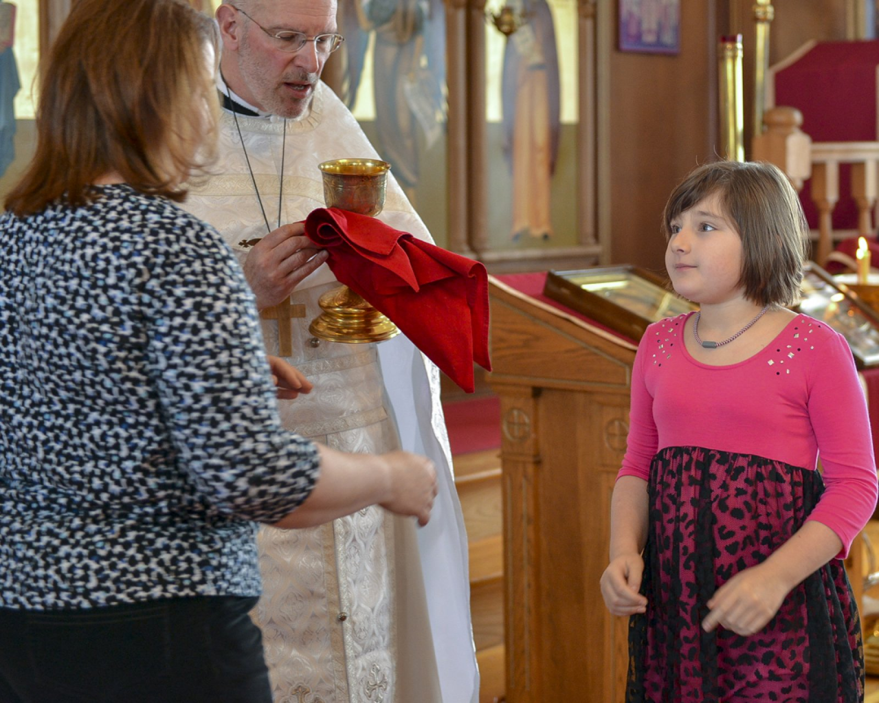
“Any Parish Can Become Vibrant…
“All that is required is that its members, beginning with its leaders, be firmly resolved to have it so.”
Fr. Thomas Hopko

Slide 9
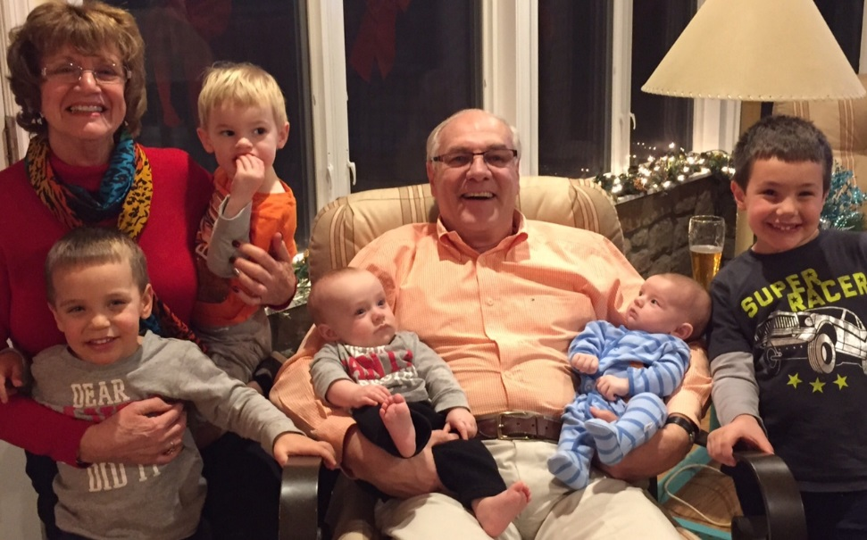
Joe Kormos
Parish Development Ministry leader,
Archdiocese of Western PA
Parish Development
Visited 82 Orthodox parishes in eight years
Over 25 multi-parish workshops & webinars
Christ the Savior – Holy Spirit Orthodox Church, Cincinnati, OH
Numerous positions

Slide 10
Hope

Slide 11
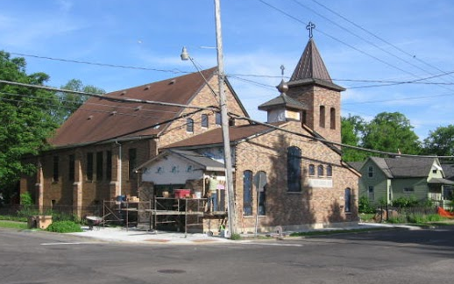
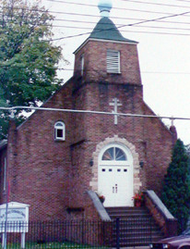
Parishes Can Become More Vibrant
“… we have a new-born ministry to the depressed neighborhood around our church, that is just taking its first steps. …the confidence to embark on that whole vision has its roots directly in the urban parish conference in Cleveland. …a difference was made, in very concrete terms, to the day-to-day life of our own local church, in ways small and very large.”
Holy Trinity Church
16 >> 84

Slide 12
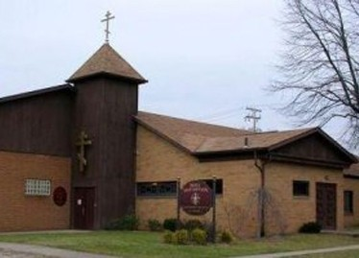
Parishes Can Become More Vibrant
Holy Assumption Church
Canton OH
“…a parish climate survey helped pinpoint avenues of growth and development. This led us to create and adopt a mission/vision statement, act upon important outreach opportunities and build a plan for the future growth of our parish.
We are currently blessed with eight catechumens.
Our Sunday attendance has increased steadily from 56 per Sunday to 85 per Sunday [one year later].
Also encouraging was the change in our financial situation.”

Slide 13
Forum Goal
For attendees to leave committed and able to take appropriate next steps in your parish.
Stimulate Commitment to Stewardship of Future
Offer Worship & Leadership Tools
Establish Communication Networks
Collaborate to Reduce Stress – Share Burden

Slide 14
Foundations of a Better Future

Slide 15
There is No Known “Parish Vibrancy” Inoculation
There are vitamins!

Slide 16
It Starts with Good Questions
How Long Do You Want Your Parish to Live?

Slide 17
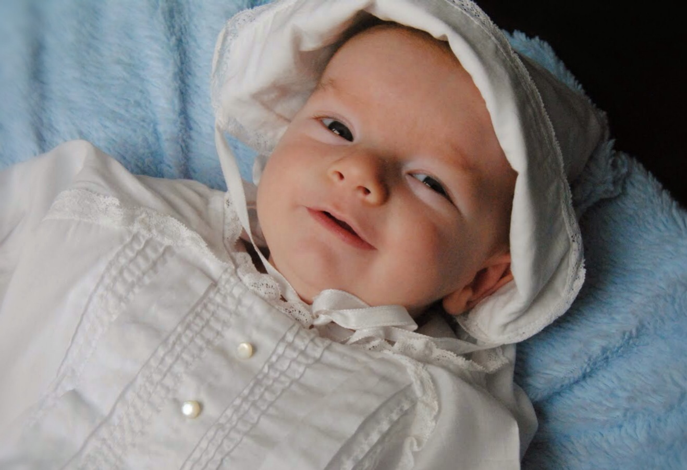
Forever → making choices on behalf of his great, great grandchildren

Slide 18
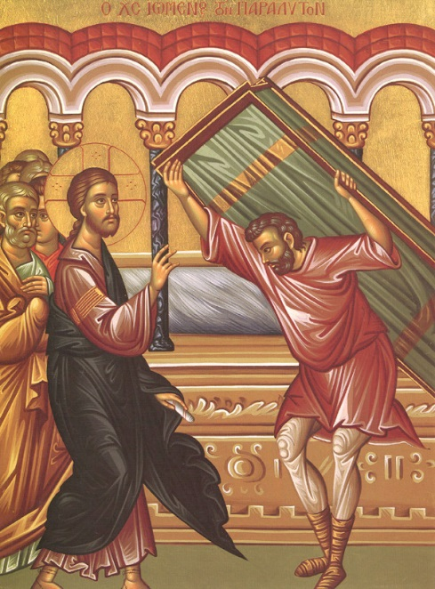
Do You Want to Be Made Well?
Paralytic at pool of Bethesda (John 5:5-7)
“Now a certain man was there who had an infirmity thirty-eight years.
When Jesus saw him lying there, and already had been in that condition a long time, He said to him, ‘Do you want to be made well?’”
The sick man answered Him, "Sir, I have no man to put me into the pool when the water is stirred up; but while I am coming, another steps down before me.“
Key Points
The man kept faith in a situation that was seemingly hopeless.
Not everyone who is ill actually desires healing.
Some prefer to remain infirm in order to have license to complain, avoid responsibility and receive pity of others.
Orthodox Study Bible
“We’re not that Holy”

Slide 19
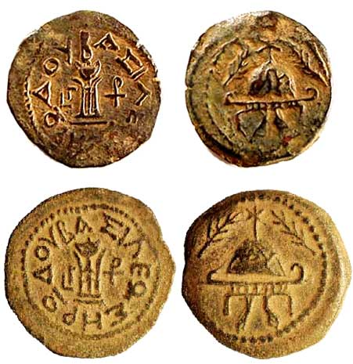
Parable of the Talents MT 25:14-30
Three stewards
First five talents
Second two
Third one
Master returns…five talents becomes ten, two becomes four.
But -- the one talent steward offered back only one.
Notes:
Well good and faithful servant vs. “wicked and slothful” third servant did not trust himself.

Slide 20
With What Are Leaders Entrusted?
Parish’s Life -- Today
Entrusted from preceding generation
To live out and proclaim the Kingdom of God
The Gospel
Conveys purposes, mission, values, and principles, which
Guides us to walk-the-talk of proclamation
Spiritual Gifts of Parishioners
Given for the fulfillment of ministry and mission in the world
Aspiration of a legacy: healthy, vital, and stronger parish
And one day entrusted in turn to next generation

Slide 21
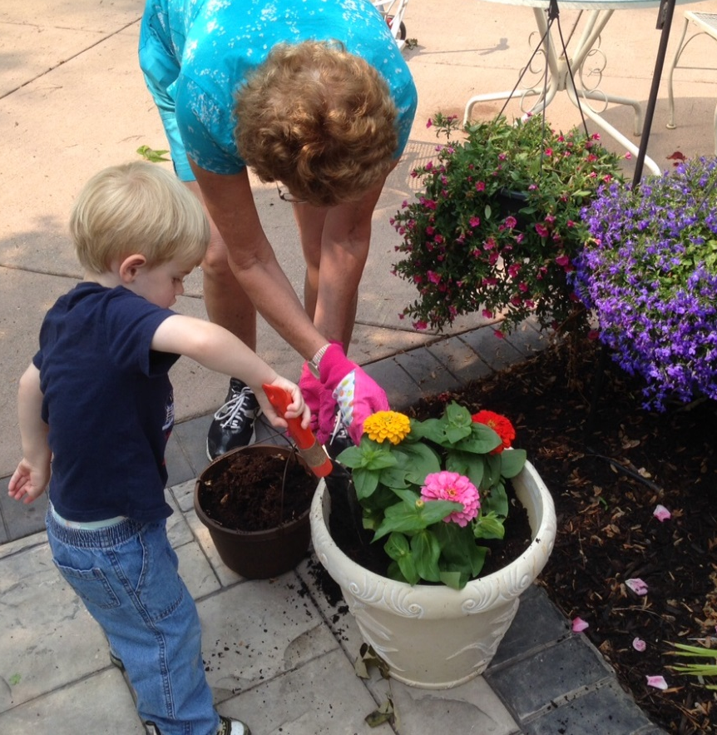
“Give Us a Growth Method”
“I have planted, Apollos watered; but God gave the increase” 1 Cor. 3:6
“You can’t make a flower grow by pulling on the petals!”

Slide 22
Acts 2:42-47
⁴² They devoted themselves to the apostles’ teaching and to fellowship, to the breaking of bread and to the prayers.
⁴³ Everyone was filled with awe at the many wonders and signs performed by the apostles.
⁴⁴ All the believers were together and had everything in common.
⁴⁵ They sold property and possessions to give to anyone who had need.
⁴⁶ Every day they continued to meet together in the temple courts.
They broke bread in their homes and ate together with glad and sincere hearts,
⁴⁷ praising God and enjoying the favor of all the people.
And the Lord added to their number daily those who were being saved.

Slide 23
Parishes Can Become More Vibrant Excerpt from Parish Warden Report
“Today we think and act differently as a parish community.
No longer are we focusing on our existence as a parish, but instead on what kind of a parish we should be.
Father ____ made the observation that we no longer spend a day selling cookies to help our finances but now spend two days to provide a weeks worth of groceries and gifts to over 200 families.
We now think less in terms of what we have accomplished but instead are thinking of how much more we can do. Can we support food efforts for 300 families, 400 families or more?”
The parish grew by 22 persons between 2007 and 2011.

Slide 24
Creed
One
Oneness & Unity
Holy
“Set apart”
…and in One, Holy,
Catholic and Apostolic Church.
Catholic
“Fullness”; “Of the whole”
Apostolic
“Sent forth”

Slide 25
Creed
…and in
One,
Holy,
Catholic
and Apostolic Church.

Slide 26
It Starts with Good Questions
Do You Want Your Parish to Grow?
Why?

Slide 27
Insular?
A common view of churches…
“an introverted society composed of ‘respectable’ people, bent on self preservation”

Slide 28
Source: Early Church
“They knew that their lives would come under close scrutiny by others so unless the Christian ethic marked their communities as a new race it would have been no good proclaiming the Christian story.”
“Evangelization in the Early Church”
Michael Green
Notes:
“Unless the Christian ethic marked [the early Christians] a new race it would have been no good proclaiming the Christian story. As a result their lives came under close scrutiny (by others).”

Slide 29
Source: Early Church
Elements of Early Christian Communities that Made Such an Impression on the World
Their Fellowship
Rich & poor
Slaves & aristocrats
Special consideration for lowly, sick needy;
Contributions: Voluntary & proportionate
Their Joy
This new faith did not make them miserable.
Jesus promised His joy as a permanent possession of the church. Can’t be taken away.
Their Transformed Character
Chastity
Hatred of cruelty
Holy living – Christ likeness of life
Their Power
Shear power of the name of Jesus healed.
Done by directing prayer to the Lord.
No sophisticated training needed.
Notes:
“Unless the Christian ethic marked [the early Christians] a new race it would have been no good proclaiming the Christian story. As a result their lives came under close scrutiny (by others).”

Slide 30
Source: The Early Church
Motivation
Gratitude
Overwhelming appreciation of the love of God experienced through Jesus Christ.
Responsibility
To share the message of God’s love
Concern
For the well being of the unevangelized – a lively awareness of the peril of those without Christ.

Slide 31
Source: The Early Church
Motivation
Gratitude
Overwhelming appreciation of the love of God experienced through Jesus Christ.
Responsibility
To share the message of God’s love
Concern
For the well being of the unevangelized – a lively awareness of the peril of those without Christ.
Not
“Growth”
Saving our parish
Increasing attendance
Paying the bills
A ride to Church

Slide 32
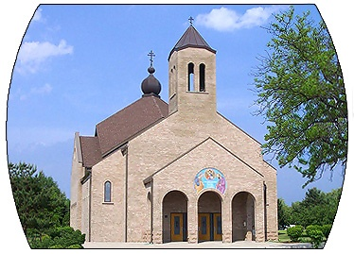
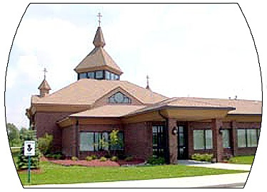
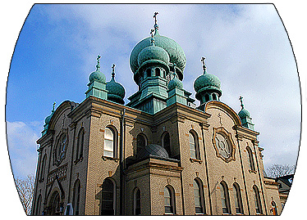
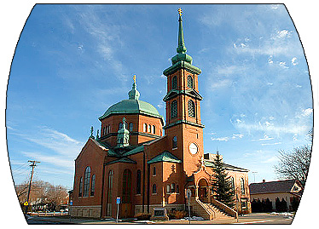
Shrinking Parishes 20 Year Numerical Change
405 >> 189
301 >> 105
3-4 % decline per year!
1014 >>349
492 >> 200

Slide 33
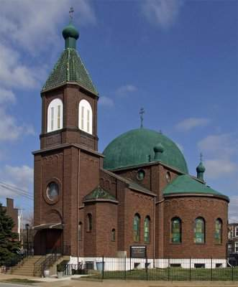
St Michael
~200 >> 15

Slide 34
Parish Census
~285
~14

Slide 35
“All is Well” – Huh!!
Excerpt from 1995 Report

Slide 36
Remember This…
“The greatest danger is the illusion that all is well.”
C.S. Lewis

Slide 37
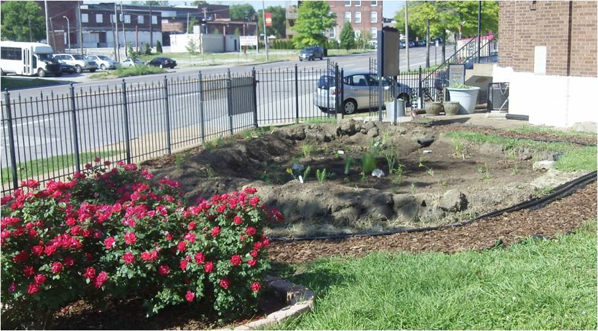
Hope
Urban Garden Welcomes Neighbors
Headquarters St Louis FOCUS

Slide 38
Qualities of Small Churches
2014 Forum Review

Slide 39
Not All Small Parishes are the Same
Founding Year
Location – Rural, Urban, In between
Parishioner demographics
Critical issues
Worship, Leadership, Stewardship, Discipleship

Slide 40
Exercise
What are the important positive qualities of small parishes.
What can small parishes do/deliver that larger, seemingly more ‘valuable’, parishes cannot

Slide 41
Positive Qualities of Small Churches
Know everyone by name (intimate)
Care about everyone
Provide assistance spontaneously w/o need for elaborate structure
Accept and affirm people who may be rejected elsewhere.
Strong adult male image to children.
Really love each other
Intergenerational
Can celebrate everyone’s victories; bear burdens
Respond when faced with a crisis

Slide 42
Small vs. Large Church Priorities
Small Church Priorities
Large Church Priorities
Relationships
The importance of everyone’s being able to call all other members by name.
The rights and privileges of each individual.
Making sure the bills are paid.
Functional aspects of ministry.
A carefully administered organizational structure.
Smooth operation of the institution.
Systematic approach to fund raising & stewardship.

Slide 43
Strengths Can Be Weaknesses
“The strong commitment of members to one another, to kinfolk’s ties, to the meeting place and concept of one big family with modest program emphasis tend to reinforce the single cell nature of the church. When combined with the intergenerational nature of a small church these forces tend to enhance the caring nature of fellowship at the cost of potential growth.
These unifying principles tend to make the small church exclusionary. This tends to make it hard for small church to reach, attract and assimilate new members (unless they have kin). The more closely knit the fellowship the more difficult it is to achieve growth.”
Lyle Shaller
The Small Church is Different
1982

Slide 44
Some Questions to be Explored
Do small parishes need to grow?
We used to be big. Now we’re small. How should we feel about that?
What is a viable parish?
Must clergy be ‘full time’? Role of tent makers?
If you learn something valuable here –what will you do with it? How will you plant seeds back home?

Slide 45
What is the Limiting Factor (Constraint) for Your Parish?
Money?
People? People committed to parish life? Sense of duty/responsibility
Passivity? People committed to Jesus Christ?
Travel distance/geography?
Demographics - Population in our town/area? Economy?
Time? Burnout?
Morale? Organization?
A sense of purpose?
An understanding of the unchurched and how to reach them?
Parking? Facilities?
Creativity/ Imagination?
Other?

